Slide 1
ELEMENTARY STATISTICAL METHODS
Dr. Reshma Reghu
Lecturer
Dept of Community Medicine

Slide 2
PRIMARY DATA
Data that is obtained directly from an individual is called primary data.
The census of 1991 is an example of collecting primary data relating to the population.
Primary data gives the precise information wanted

Slide 3
SECONDARY DATA
Data that is obtained from outside source is called secondary data.
If we are studying the hospital records. and want to use the census data, the census data becomes secondary data.

Slide 4
Presentation of Statistical Data
Statistical data, once collected, must be arranged purposively, in order to bring out the important points clearly and strikingly. Therefore the manner in which statistical data is presented is of utmost importance. There are several methods of presenting data- tables, charts, diagrams, graphs, pictures and special curves.

Slide 5
TABULATION
Tables are devices for presenting data simply from masses of statistical data. Tabulation is the first step before the data is used for analysis or interpretation. A table can be simple or complex, depending upon the number or measurement of a single set or multiple sets of items.

Slide 6
General principles in designing tables
The tables should be numbered e.g., Table 1, Table 2, etc.
(b) A title must be given to each table. The title must be brief and self explanatory.
(c) The headings of columns or rows should be clear and concise.
(d) The data must be presented according to size or importance; chronologically, alphabetically or geographically,.
(e) If percentages or averages are to be compared, they should be placed as close as possible.
(f) No table should be too large.
(g) Most people find a vertical arrangement better than a horizontal one because, it is easier to scan the data from top to bottom than from left to right,.
(h) Foot notes may be given, where necessary, providing explanatory notes or additional information.

Slide 7
TYPES
Simple Tables
Frequency Distribution Table

Slide 8
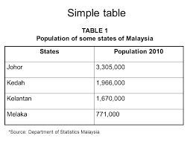

Slide 9
Frequency Distribution Table
In a frequency distribution table, the data is first split up into convenient groups (class intervals) and the number of items (frequency) which occur in each group is shown in the adjacent column.
As a practical rule, it might be stated that when there is large data, a maximum of 20 groups, and when there is not much data, a minimum of 5 groups, could be conveniently taken.
As far as possible, the class intervals should be equal, so that observations could be compared.
The merits of a frequency distribution table are, that it shows at a glance how many individual observations are in a group, and where the main concentration lies.
It also shows the range, and the shape of distribution. ·

Slide 10
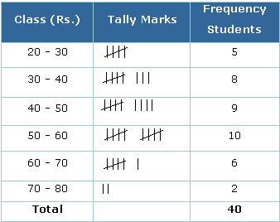

Slide 11
CHARTS AND DIAGRAMS
Charts and diagrams are useful methods of presenting simple statistical data. They have a powerful impact on the imagination of people. Therefore, they are a popular media of expressing statistical data, especially in newspapers and magazines. The impact of the picture depends on the way it is drawn.

Slide 12
Few remarks
Diagrams are better retained in the memory than statistical tables.
The data that is to be presented by diagrams ought to be simple.
Then there is no risk that the reader will misunderstand. However, simplicity may be obtained only at the expense of details and accuracy. That is, lot of details of the original data may be lost in the charts and diagrams. If we want the real study, we have to go back to the original data.

Slide 13
Bar charts
They are diagrams of Qualitative Data
Usually prefered for scientific presentation
Bar charts are merely a way of presenting a set of numbers by the length of a bar, the length of the bar is proportional to the magnitude to be represented.
Bar charts are a popular media of presenting statistical data because they are easy to prepare, and enable values to be compared visually.

Slide 14
SIMPLE BAR CHART
Bars may be vertical or horizontal.
The bars are usually separated by appropriate spaces with an eye to neatness and clear presentation.
A suitable scale must be chosen to present the length of the bars.

Slide 15
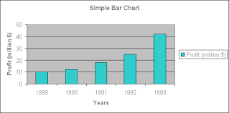

Slide 16
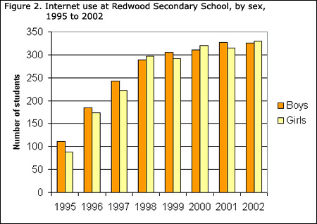
MULTIPLE BAR CHART
Two or more bars can be grouped

Slide 17
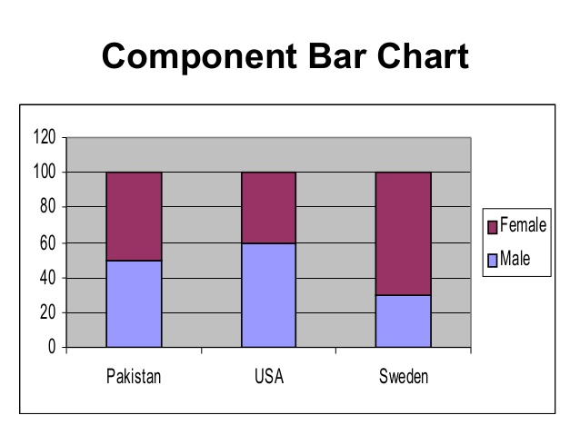
COMPONENT BAR CHART
The bars may be divided into two or more parts ... Each part representing a certain item and proportional to the magnitude of that particular item.

Slide 18
HISTOGRAM
It is a pictorial diagram of frequency distribution.
It consists of a series of blocks.
The class intervals are given along the horizontal axis and the frequencies along the vertical axis.
The area of each block or rectangle is proportional to the frequency.
Diagramatic representation of quantitative data

Slide 19
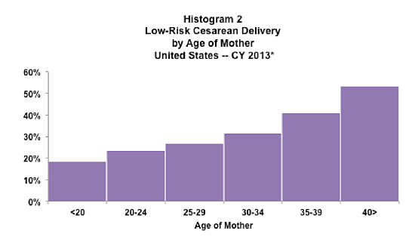

Slide 20
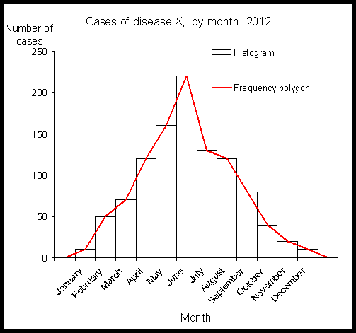
FREQUENCY POLYGON
A frequency distribution may also be represented diagrammatically by the frequency polygon.
It is obtained by joining the mid-points of the histogram blocks.

Slide 21
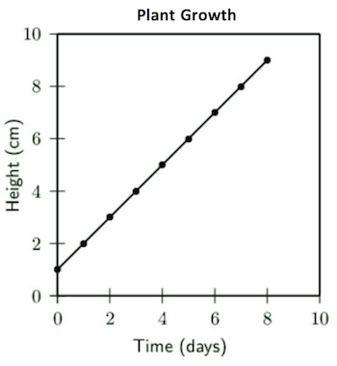
LINE DIAGRAM
Line diagrams are used to show the trend of events with the passage of time.

Slide 22
PIE CHART
Instead of comparing the length of a bar, the areas of segments of a circle are compared.
The area of each segment depends upon the angle.
Pie charts are extremely popular with the laity, but not with statisticians who consider them inferior to bar charts.
It is often necessary to indicate the percentages in the segments as it may not be sometimes very easy, virtually, to compare the areas of segments.

Slide 23
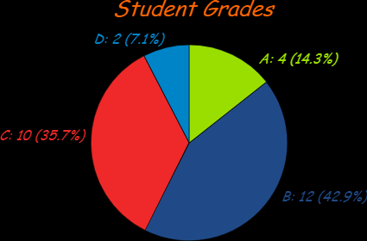

Slide 24
PICTOGRAMS
Pictograms are a popular method of presenting data to the "man in the street" and to those who cannot understand orthodox charts.
Small pictures or symbols are used to present the data. For example, a picture of doctor to represent the population per physician.
Fractions of the picture can be used to represent numbers smaller than the value of a whole symbol.
In essence, pictograms are a form of bar charts. ·

Slide 25
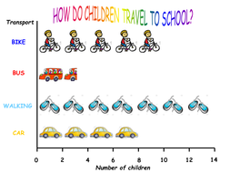

Slide 26
STATISTICAL MAPS
When statistical data refer to geographic or administrative areas, it is presented either as "Shaded Maps“ or "Dot maps" according to suitability.
The shaded maps are used to present data of varying size. The areas are shaded with different colours, or different intensities of the same colour, which is indicated in the key.
Scatter diagram shows the relationship between two variables,

Slide 27
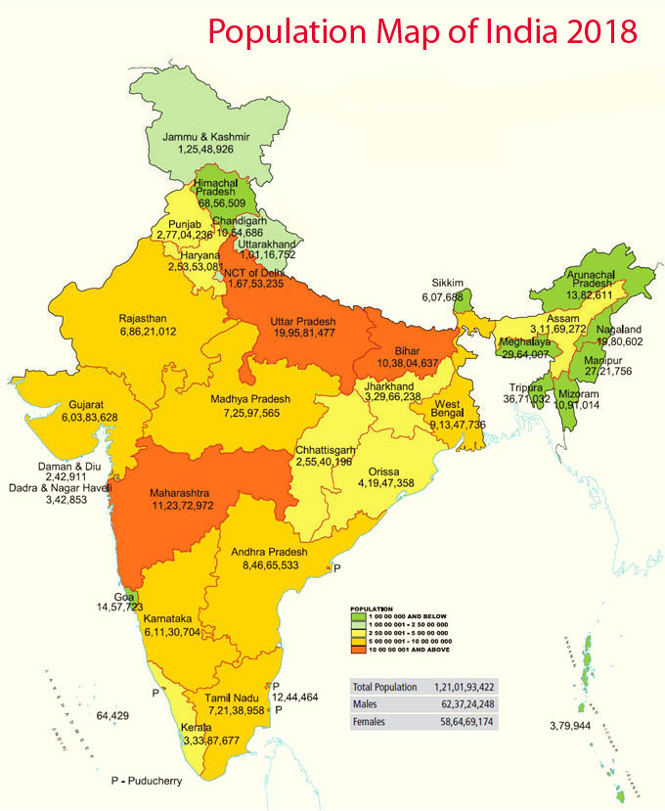
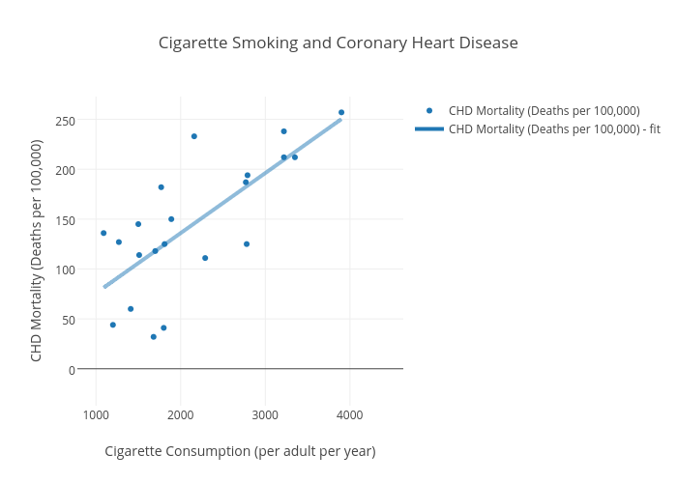
SPOTTED MAPS & SCATTER DIAGRAMS

Slide 28
STATISTICAL AVERAGES
The word "average" implies a value in the distribution, around which the other values are distributed.
Commonly used are : -
(1) The Arithmetic Mean
(2) Median and
(3) The Mode

Slide 29
MEAN
The arithmetic mean is widely used in statistical calculation. It is sometimes simply called Mean.
To obtain the mean, the individual observations are first added together, and then divided by the number of observations.
The operation of adding together is called 'summation' and is denoted by the sign Σ or S.
The individual observation is denoted by the sign ŋ and the mean is denoted by the sign X (called "X bar").

Slide 30
The advantages of the mean are that it is easy to calculate and understand.
The disadvantages are that sometimes it may be unduly influenced by abnormal values in the distribution.

Slide 31
MEDIAN
The median is an average of a different kind, which does not depend upon the total and number of items.
To obtain the median, the data is first arranged in an ascending or descending order of magnitude, and then the value of the middle observation is located, which is called the median.

Slide 32
MODE
The mode is the commonly occurring value in a distribution of data. It is the most frequent item or the most "fashionable" value in a series of observations.
For example, the diastolic blood pressure of 20 individuals was :
85, 75,81, 79, 71,95, 75, 77, 75,90,
71, 75, 79,95, 75, 77,84, 75,81, 75
The mode or the most frequently occurring value is 75.

Slide 33
The advantages of mode are that it is easy to understand, and is not affected by the extreme items.
The disadvantages are that the exact location is often uncertain and is often not clearly defined.
Therefore, mode is not often used in biological or medical statistics.

Slide 34
MEASURES OF DISPERSION
There are several measures of variation (or "dispersion“ as it is technically called) of which the following are widely known:
(a) The Range
(b) The Mean or Average Deviation
(c) The Standard Deviation

Slide 35
RANGE
The range is by far the simplest measure of dispersion. It is defined as the difference between the highest and lowest figures.
It indicates only the extreme values between the two values and nothing about the dispersion of values between the two extreme values.

Slide 36
MEAN DEVIATION
It is the average of the deviations from the arithmetic mean.

Slide 38
The Standard Deviation
The standard deviation is the most frequently used measure of deviation. In simple terms, it is defined as "Root Means Square Deviation.“
It is denoted by the Greek letter sigma or by the initials S.D.

Slide 39
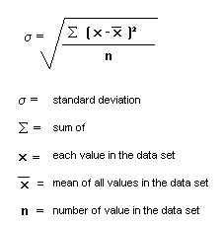
When the sample size is more than 30

Slide 40
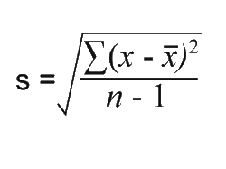
When the sample size is less than 30

Slide 41
NORMAL DISTRIBUTION
The normal distribution or 'normal curve' is an important concept in statistical theory.
The shape of the curve will depend upon the mean and standard deviation which in turn will depend upon the number and nature of observations.
It is useful to note at this stage that in a normal curve
(a). the area between one standard deviation on either side of the mean ( x ± 1 S.D ) will include approximately 68 per cent of the values in the distribution,
(b) the area between two standard deviations on either side of the mean ( x ± 2 S.D ) will cover most of the values, i.e., approximately 95 per cent of the values, and
(c) the area between ( x ± 3 S.D ) will include 99. 7 per cent of the values. These limits on either side of the mean are called "confidence limits"

Slide 42
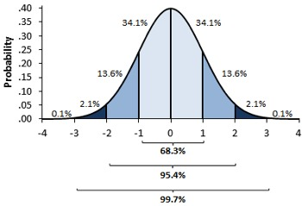
NORMAL CURVE

Slide 44
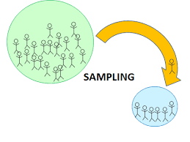

Slide 45
SAMPLING
The process of selecting a representative part from the whole is called Sampling.
The whole from which the sample is drawn is called Population
The whole may be finite or infinite. So it is denoted as Universe

Slide 46
SAMPLING FRAME
A sampling frame is a listing of the members of the universe from which the sample is to be drawn. The accuracy and completeness of the sampling frame influences the quality of the sample drawn from it.

Slide 47
SAMPLING METHODS
Simple Random Sampling
Systematic Random sampling
Stratified Random Sampling

Slide 48
ERRORS
Sampling Errors
The variation in the result of one sample to another is Sampling Error. It is inherent to the sampling procedure.
Factors that influence the Sampling Error
Size of the sample
Natural variability of the individual reading

Slide 49
Non- Sampling Error
Errors may occur due to inadequately calibrated instruments, due to observer variation as well as due to incomplete coverage in examining the subjects selected and conceptual errors.
These are often more important than sampling errors.

Slide 50
Standard Error
S. E is defined as the Standard deviation of repeated sample means or proportions taken from same population.
It is a very effective standard deviation which is close to the true value of the population.
It is the fundamental tool used in Statistics for estimation and tests of significance.

Slide 51
Test of Significance
Standard Error of the Mean
Standard Error of Proportion
Standard Error of Difference
Standard Error of Difference between two Proportions.

Slide 52
STANDARD ERROR OF THE MEAN

Slide 53
STANDARD ERROR OF PROPORTION

Slide 54
STANDARD ERROR OF DIFFERENCE BETWEEN 2 MEANS

Slide 55
STANDARD ERROR OF DIFFERENCE BETWEEN PROPORTIONS

Slide 56
HYPOTHESIS-
sort of prediction or anticipated happening
SIGNIFICANCE
stage of doubt or research question

Slide 57
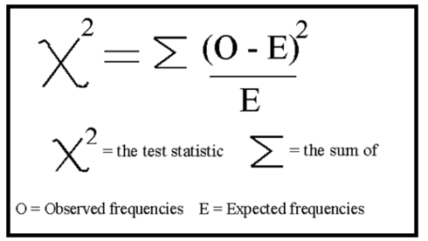
CHI- SQUARE TEST
An alternate method of testing the significance of difference between two proportions.

Slide 58
Testing the significance of difference between 2 proportions
Test the Null Hypothesis
Applying Chi- square test
Finding the Degree of freedom
Probability Tables

Slide 60
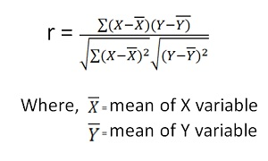
FORMULA

Slide 61
REGRESSION
Regression means prediction
In bivariate correlation, one variable may measurable and other may not. Then the prediction of unknown variable with mathematical relationship.

Slide 62
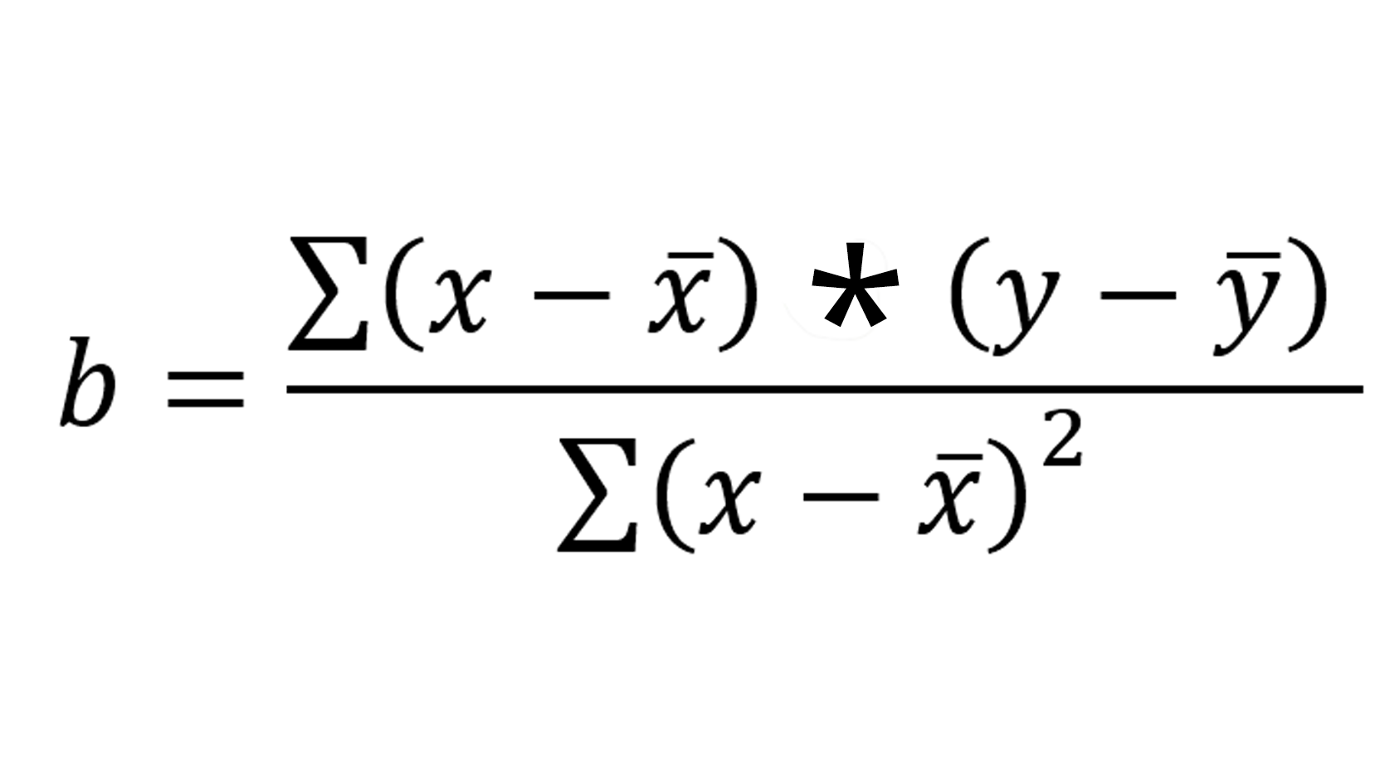
REGRESSION COEFFICIENT FORMULA

